Slide 1
Neural Network Laboratory Project
Group K:
Emilio Gómez Esteban
Fernando Javier López Cerezo
Enrique Pérez Haro
Juan José Rodríguez Hernández

Slide 2
Index
Training and Validation samples generation
Multilayer perceptron training
Test samples generation and simulation
Results

Slide 3
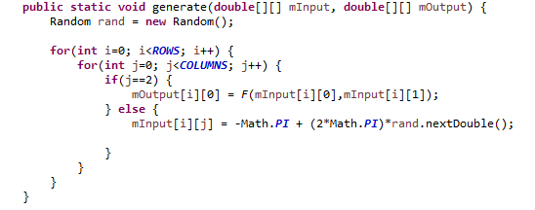
Training and Validation samples generation
We have implemented this method to firstly generate 1000 random training samples (x,y), secondly generate 1000 random validation samples (x,y) and lastly to compute the value of the function F(x,y)=sin(x)*cos(y) at those points. We save (x,y) values at a 2x1000 matrix called mInput and F(x,y) values at a 1x1000 matrix called mOutput. Pairs (x,y) are from [-pi,pi]x[-pi,pi].

Slide 4
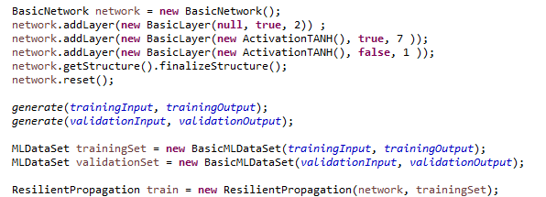
Multilayer Perceptron Training
We initialize the network with the functions of the library. We use 7 neurons in the hidden layer. Firstly, weights were 0 and then using network.reset() we randomize them. The function selected as Activation function is the Hyperbolic Tangent because it takes values from [-1,1] like our target function. To train the neural network we have to use data structures provided by the Encog libraries.

Slide 5
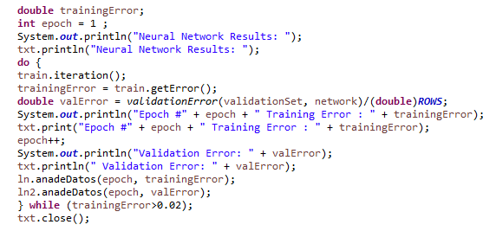
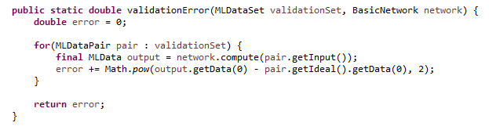
For the training of the neural network, we keep doing iterations until the training error is below 0.02. To calculate the training error we use a method implemented by the library, and for the validation error we have implemented a function that calculates the mean squared error. In each iteration we show the training and validation errors in a .txt file.

Slide 6
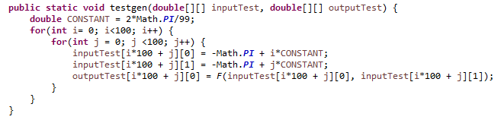

Test samples generation and simulation
To generate the test samples of (x,y) in a grid os 100x100 points on the square [-pi,pi]x[-pi,pi] we have implemented the method testgen which divides the interval [-pi,pi] into 100 segments of same length (both for x and y values). Then we compute F(x,y) at those points. Lastly, the simulation of the multilayer perceptron on the test samples takes place to calculate the mean squared error.

Slide 7
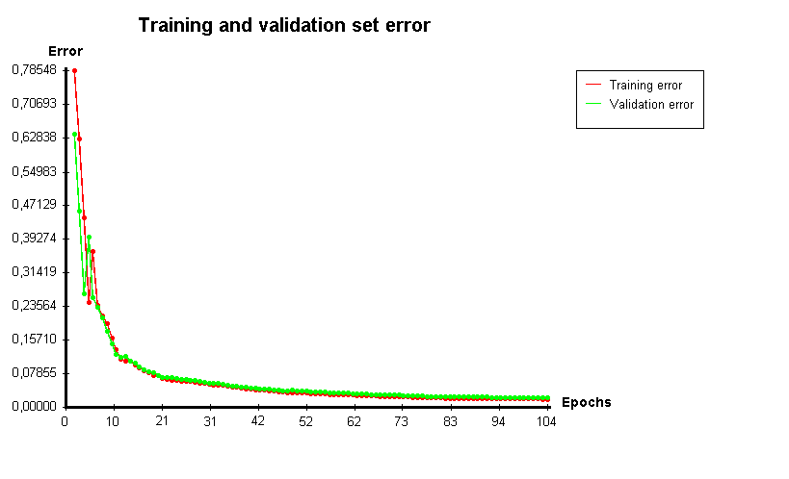
Results

Slide 8
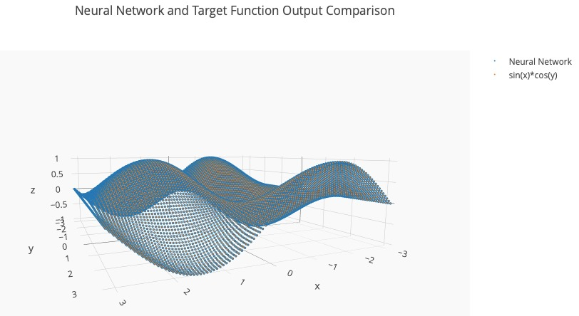
Results

